Slide 1
Lecture 23-Supplement

Slide 2
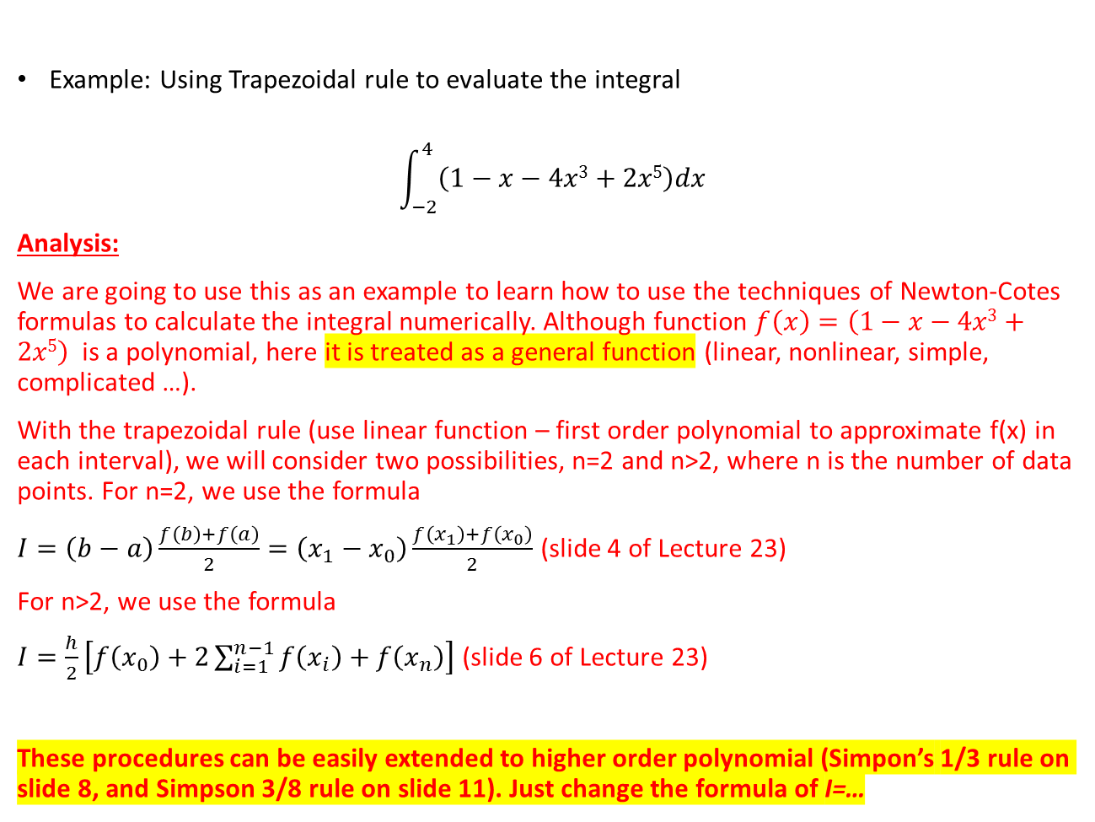
Numerical Integration Formulas
Example: Using Trapezoidal rule to evaluate the integral
$$\int_{−2}^{4}{\left(1−x−4x3+2x5\right)dx}$$
Analysis:
We are going to use this as an example to learn how to use the techniques of Newton-Cotes formulas to calculate the integral numerically. Although function $f\left(x\right)=\left(1−x−4x3+2x5\right)$ is a polynomial, here it is treated as a general function (linear, nonlinear, simple, complicated …).
With the trapezoidal rule (use linear function – first order polynomial to approximate f(x) in each interval), we will consider two possibilities, n=2 and n>2, where n is the number of data points. For n=2, we use the formula
$I=\left(b−a\right)\frac{f\left(b\right)+f\left(a\right)}{2}=\left(x_{1}−x_{0}\right)\frac{f\left(x_{1}\right)+f\left(x_{0}\right)}{2}$ (slide 4 of Lecture 23)
For n>2, we use the formula
$I=\frac{h}{2}\left[f\left(x_{0}\right)+2\sum_{i=1}^{n−1}{f\left(x_{i}\right)}+f\left(x_{n}\right)\right]$ (slide 6 of Lecture 23)
These procedures can be easily extended to higher order polynomial (Simpon’s 1/3 rule on slide 8, and Simpson 3/8 rule on slide 11). Just change the formula of I=…
Notes:
I am going to integrate from -2 to 4.
I am going to use the trapezoidal rule
Basically, this is the first y value, this is the last y value. These are the intermediate ones.

Slide 3
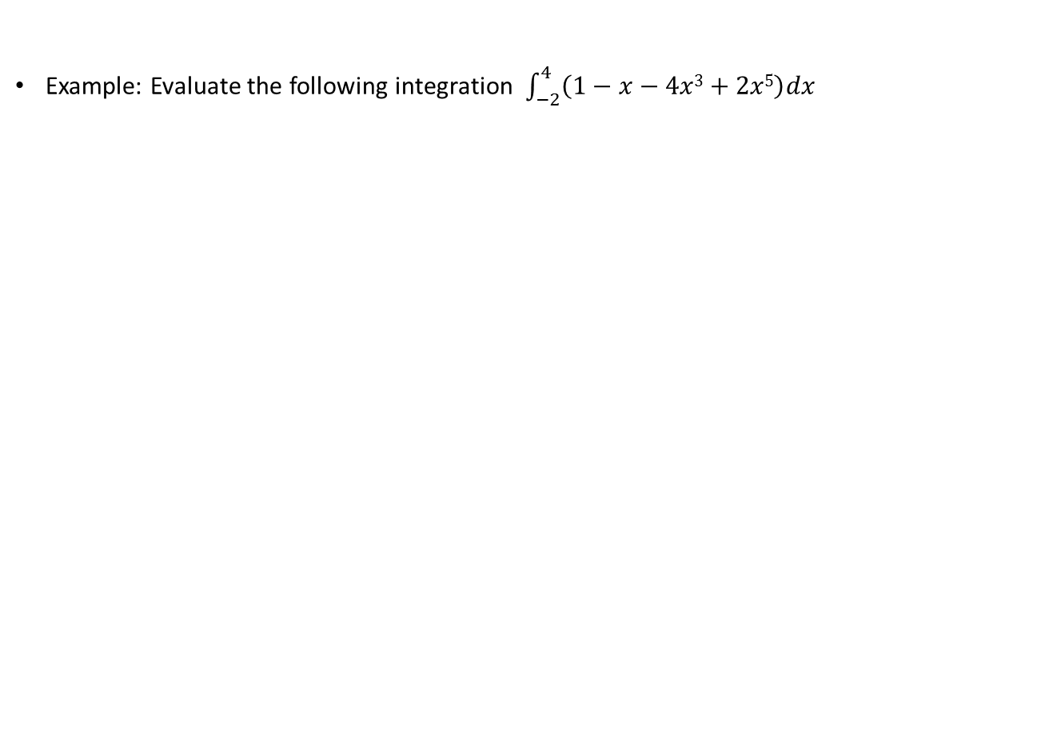
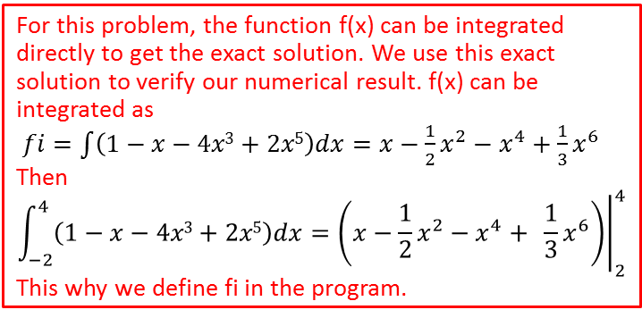

Numerical Integration Formulas
Example: Evaluate the following integration $\int_{−2}^{4}{\left(1−x−4x3+2x5\right)dx}$
clc
clear
f = @(x) 1-x-4*x.^3+2*x.^5; % Function f(x)
fi = @(x) x-x.^2/2-x.^4+x.^6/3; % Exact integration of f(x)
n = input(‘Enter the number of points to use: ’);
if n<= 1
n = 2
end
a = -2;
b = 4;
IE = fi(b) – fi(a); % Exact value of integration
x = linspace(a,b,n);
y = f(x);
h = x(2) – x(1); % Distance between points
if n==2
I = h*(y(1)+y(2))/2;
else
I = (h/2)*(y(1)+2*sum(y(2:n-1))+y(n));
end
fprintf(‘The calculated area is equal to = %.4f\n’, I);
fprintf(‘The exact area is equal to = %.4f\n’, IE);
The function to calculate the integral
For this problem, the function f(x) can be integrated directly to get the exact solution. We use this exact solution to verify our numerical result. f(x) can be integrated as
$fi=\int{\left(1−x−4x3+2x5\right)dx}=x−\frac{1}{2}x^{2}−x^{4}+$ $\frac{1}{3}x^{6}$
Then
$$\int_{−2}^{4}{\left(1−x−4x3+2x5\right)dx}={\left.\left(x−\frac{1}{2}x^{2}−x^{4}+ \frac{1}{3}x^{6}\right)\right|}_{2}^{4}$$
This why we define fi in the program.
Trapezoidal Rule:
Two data points:
$I=\left(b−a\right)\frac{f\left(b\right)+f\left(a\right)}{2}$
More points:
$I=\frac{h}{2}\left[f\left(x_{0}\right)+2\sum_{i=1}^{n−1}{f\left(x_{i}\right)}+f\left(x_{n}\right)\right]$
Please pay attention to the application of sum() function
When extending the program to Simpson’s 1/3 and 3/8 rules, just change the expression of I in the program
Notes:
I am going to integrate from -2 to 4.
I am going to use the trapezoidal rule
Basically, this is the first y value, this is the last y value. These are the intermediate ones.

